Slide 1
Chapter 6: Test Management
Software Testing
Lecture 23
Test Plan Document

Slide 2

Test Plan
A plan is an arrangement, a pattern, a program, or a scheme for a
definite purpose
Test Plan is document describing:
- Scope
- Approach
- Resources
- Schedule
Outlines:
- Test Strategy, testing objectives, resources
- Test Schedule, test estimation and test deliverables.

Slide 3
Test Plan and Test Strategy
Test Plan
Derived from SRS
Prepared by test lead or manager
Goal is to answer:
- What to test
- When to test
- How to test
- Who will be the tester
If SRS change than Test Plan also needs to update
Test Strategy
Derived from Business Requirement document
Prepared by project manager or business analyst
Static document and not updated often.

Slide 4
TEST PLAN TYPES
Following types of test plans:
Master Test Plan: A single high-level test plan for a project/product that unifies all other test plans.
Testing Level Specific Test Plans: Plans for each level of testing.
Unit Test Plan
Integration Test Plan
System Test Plan
Acceptance Test Plan
Testing Type Specific Test Plans: Plans for major types of testing like Performance Test Plan and Security Test Plan.

Slide 5

Importance of Test Plan
Helps in understand
Guides our thinking
Helps in reviewing important documents
Helps us to validate the quality of application

Slide 6
How to write a Test Plan
Follow the steps below to write test plan according to IEEE 829
1. Analyze the product
- Thoroughly learn the product e.g banking website for testing
(who will use website, what it is used for?, How will it work, what are s/s and hardware it uses
2. Design the Test Strategy
- Testing objectives, determines the testing effort and cost
3. Define the Test Objectives
- List all the software features (Functionality, performance,GUI etc) which
needs to test
- Define the target or goal of the test based on above features.
4. Define Test Criteria
- Suspension Criteria and Exit Criteria

Slide 7
How to write a Test Plan
5. Resource Planning
- Detailed summary of all types of resources required to complete project task
6. Plan Test Environment
- Setup of software and hardware to execute tests
7. Schedule & Estimation
- Estimate the effort to complete the project and schedule
8. Determine Test Deliverables
- List of all the documents, tools and other components that has to be
developed and maintained in support of the testing effort

Slide 8
Test Plan Template
The format and content of a software test plan vary depending on the processes, standards, and test management tools being implemented.
We will discuss the format, which is based on IEEE standard for software test documentation, provides a summary of what a test plan can/should contain.

Slide 9
Test Plan Document with IEEE Standard 829-1998
Test Plan Identifier:
Specify uniquely the name and version of the test plan.
Number also identify the type of test plan (master, level, specific)
Introduction:
Describe the purpose of the test plan.
Specify the goals/objectives.
References:
- List all documents that support this test plan
Test Items:
List the test items (software/products) and their versions to be tested.
These are things you intend to test within the scope of this test plan

Slide 10
Test Plan Document with IEEE Standard 829-1998
Features to be Tested:
List the features of the software/product to be tested.
Provide references to the Requirements and/or Design specifications of the features to be tested
Features Not to Be Tested:
List the features of the software/product which will not be tested.
Specify the reasons these features won’t be tested.
Test Approach:
Mention the Overall test strategy for this test plan.
Specify the testing levels [if it’s a Master Test Plan], the testing types, and the testing methods (Manual/Automated; White Box/Black Box/Gray Box and should be in agreement with all higher and lower levels of plans.
Overall rules and processes should be identified.

Slide 11
Test Plan Document with IEEE Standard 829-1998
Item Pass/Fail Criteria:
Specify the criteria that will be used to determine whether each test item (software/product) has passed or failed testing.
Suspension Criteria and Resumption Requirements:
Specify criteria to be used to suspend the testing activity.
Specify testing activities which must be redone when testing is resumed.
Test Deliverables:
What is to be delivered as part of this plan? including the following:
Test Plan (this document itself)
Test Cases
Test Scripts
Tests Logs
Test Reports etc

Slide 12
Test Plan Document with IEEE Standard 829-1998
Test Environment:
Specify the properties of test environment: hardware, software, network etc.
List any testing or related tools.
Estimate:
Provide a summary of test estimates (cost or effort) and/or provide a link to the detailed estimation.
Schedule:
Provide a summary of the schedule, specifying key test milestones, and/or provide a link to the detailed schedule.
Staffing and Training Needs:
Specify staffing needs by role and required skills.
Identify training that is necessary to provide those skills, if not already acquired.

Slide 13
Test Plan Document with IEEE Standard 829-1998
Responsibilities:
List the responsibilities of each team/role/individual.
Risks:
List the risks that have been identified.
Specify the mitigation plan and the contingency plan for each risk.
Assumptions and Dependencies:
List the assumptions that have been made during the preparation of this plan.
List the dependencies.
Approvals:
Specify the names and roles of all persons who must approve the plan.
Provide space for signatures and dates. (If the document is to be printed.)

Slide 14
TEST PLAN GUIDELINES
Make the plan concise
Avoid redundancy
Be specific
Make use of lists and tables wherever possible
Review your document for number of times
Update the plan when necessary

Slide 15
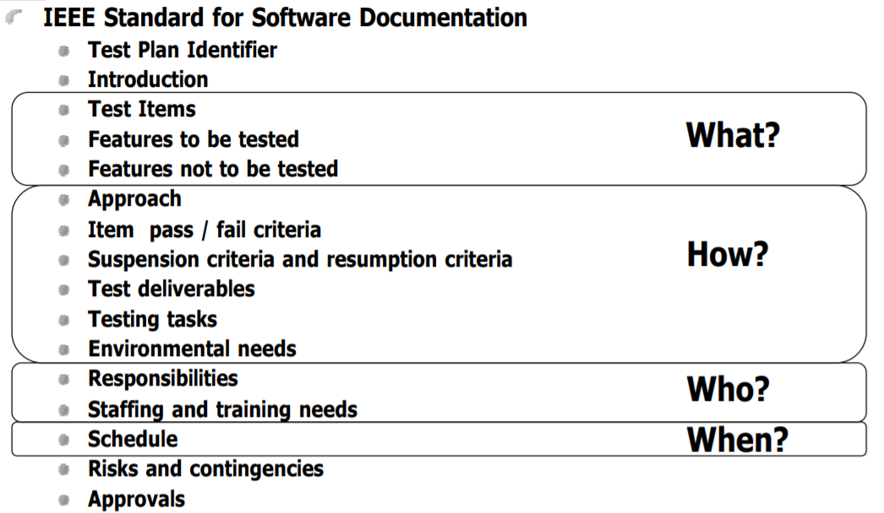
Test Plan Document with IEEE Standard 829-1998

Slide 16
Thank you

